Slide 1
Trauma-informed Practices in Adult Education
Katie Donoviel
English Skills Learning Center

Slide 2
Overview
WARM UP
LEARN
Theory
Brain-based learning
Affective Filter
Culturally Responsive Teaching
Trauma Basics
Responding to Someone in Crisis
APPLY
Areas of Consideration
Registering New Students
Designing Curriculum and Materials
Approaching Instruction
Maintaining Student Privacy
REVIEW
NOTE: I am an educator sharing what I have learned about trauma and how educators can use trauma-informed practices to create more welcoming environment for EVERYONE.

Slide 3
WARM UP

Slide 4
Word Association
Great Teaching

Slide 5
LEARN

Slide 6
Brain-based Learning Theory
A healthy body promotes a healthy mind. Bring movement into the classroom.
Emotions are key to memory, meaning, and attention
Interaction with others benefits brain development
Teaching each other boosts memory
Memory improves through practice
Long lectures are ineffective
Content has to be meaningful
Information has to be moved from short- to long-term memory
Stress impairs learning
Swan, M. (2019). What is brain-based learning? Retrieved from https://www.classcraft.com/blog/what-is-brain-based-learning/

Slide 7
Affective Filter Hypothesis
When filter is high, students…
Feel stressed and anxious
Lack self-confidence
Have reluctance to participate
When filter is low, students…
Become risk-takers in the classroom
Feel safe making mistakes without judgement
Feel empowered to interact with their peers

Slide 8
Culturally Responsive Teaching
Multicultural Education | Social Justice Education | Culturally Responsive Teaching
Focuses on celebrating diversity | Focuses on exposing the social political context that student experience | Focuses on improving learning capacity of diverse students who have been marginalized educationally.
Centers around diversity and inclusion efforts | Centers around anti-racists efforts | Centers around efforts to accelerate learning
Concerns itself with exposing privileged students to multiple prescriptives and other cultures. Fro students of color, focus is on seeing themselves reflected in the curriculum. | Concerns itself with creating a lens to recognize and interrupt inequitable patterns and practices in society. | Concerns itself with building cognitive capacity and academic mindset by pushing back on dominant narratives about people of color.
Goal: Social Harmony | Goal: Critical Consciousness | Goal: Independent Learning for Agency

Slide 9
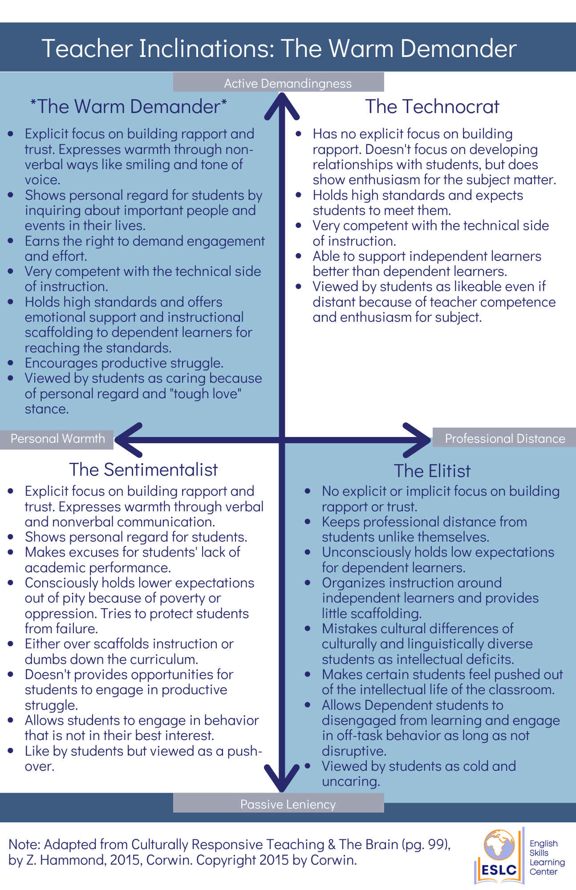

Slide 10
Jigsaw
Expert Group
Read your handout independently
Discuss the handout with your group
Be prepared to share a summary with other groups
Jigsaw Group
Form new groups, containing one member of each expert group
Share the information from your expert group
Whole Group
Discuss together

Slide 11
What is Trauma? The 3 Es
“Trauma is the short and long-term adverse effects on an individual’s functioning and mental, physical, social, emotional, and/or spiritual well-being, resulting from an event (or series of events or circumstances) an individual has experienced as physically and/or emotionally harmful or life threatening.”
Substance Abuse and Mental Health Services Association (SAMHSA)

Slide 12
What Does a Trauma Response Look Like? The 4 Fs
The ways in which people respond when overwhelmed, stressed, or in relation to traumatic incidents.
FIGHT - defensive, anger, explosive behavior, controlling
FLIGHT - anxiety, perfectionism, panic, removing oneself
FREEZE - isolation, difficulty making decisions, zoning out
FAWN - people pleasing, lack of identity, no boundaries

Slide 13
What Does it Mean to be Trauma Aware? The 4 Rs
Trauma-awareness is guided by four assumptions, known as the “Four Rs”
Being trauma-aware means having a realization of what trauma is and how it can affect people and groups. Recognizing the signs of trauma and having a system which can respond to trauma, and resisting re-traumatization.

Slide 14
What Does it Mean to be Trauma-informed? The 6
Safety
Trustworthiness and Transparency
Peer Support and Mutual Self-help
Collaboration and Mutuality
Empowerment , Voice, and Choice
Cultural, Historical, and Gender Issues

Slide 15
Responding to Someone in Crisis
Act calm, even if you’re not
**Ask them if they want a glass of water
Actively listen and respect privacy
Don’t try to problem solve for them (with --maybe)
Remember your own boundaries
Refer to professional services, as appropriate
Follow up with ways to cope with vicarious trauma

Slide 16
APPLY

Slide 17
Areas of Consideration
Registering New Students
Designing Curriculum and Materials
Approaching Instruction
Maintaining Student Privacy

Slide 18
Registration
Position students so they have a full view of the entry
Sit at a 90-degree angle from students, not across a table
Dress a bit more casual if doing intake/registration
Warn students that you’ll be asking them personal questions
Explain why you need the information
Explain what you are doing if you have to leave the room or stand up suddenly
Have water and tissues at the ready
Be ready to listen, not just collect data points
Use translation/interpretation whenever possible

Slide 19
Curriculum and Materials
Predicting ALL potentially triggering topics is impossible, but you can be smart about it!
Rather than avoiding topics, provide a warning when you think topics might be triggering
Consider the images you use (e.g., health literacy)
Give students agency over topics, when possible
Use relevant, age- and level-appropriate materials with differentiation
Scaffold to build independent learners

Slide 20
Instruction
Be the “warm demander”
Focus on building rapport between teachers and students as well as between students
Differentiate approaches and scaffolding
Establish classroom routines to provide predictability and consistency
Provide a preview of the day and outline goals / objectives
Consider when and how to provide corrective feedback
Remember to provide genuine positive feedback
Allow for translanguaging, as appropriate

Slide 21
Privacy
Don’t pry for information. You don’t have a right to anyone’s story.
Keep information confidential, as possible
Consider ways to cope with vicarious trauma without revealing students’ identities
Be mindful of what you discuss in the presence of others (coworkers, family, friends, and other students)

Slide 22
REVIEW

Slide 23
3, 2, 1 Exit Ticket
3 Concepts you learned or reviewed today
2 Concepts you want to learn more about
1 Concept you can apply immediately

Slide 24
Thank you! Questions?
Katie Donoviel
k.donoviel@eslcenter.org

